Slide 1

A Guide to Problem Solving
Using Soft computing

Slide 2
INTRODUCTION
In this chapter, we discuss some of the very common mistakes that people make, along with some of the common issues and problems that the people face.
This chapter is devoted to the study the systems that we have been using and to point out ways of using them for the creation of systems without bugs and that perform very well in real-life scenarios.
This chapter acts as a working guide to the readers to consult for all the general queries, problems, and issues related to soft computing.
In short, this chapter is a small, informal discussion of the myths, beliefs, misconceptions, and real picture of soft computing.

Slide 3
ANN WITH BPA
This is one of the most common algorithms that we use in this text. This algorithm always performed well and achieved decent accuracies for whatsoever problems it was applied to.
In practice, however, when you train an ANN, the results may not always be good.
Many times the system shows good performance in the training data set but fails in the testing data set.
We highlight some major reasons or mistakes that designers commit one by one.

Slide 4
Number of Hidden Layers
The ANN can imitate almost anything that one may imagine.
The sad part is that this appearance is deceiving.
Every hidden layer leads to a tremendous increase in the dimensionality of the problem in the error or the configuration space, where the training algorithm is now supposed to find the global optima in a larger section of more dimensions.
This makes it very hard for the ANN to find global optima.
Hence the ANN is very likely to keep getting trapped in these valleys and have no idea how to reach the final global optima.

Slide 5
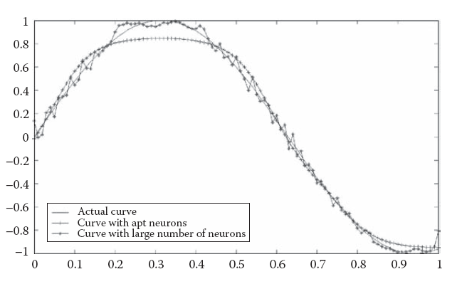
Number of Hidden Layers
In order to better understand this, let us train a data set with outputs corresponding to some known function by two ANNs.
One will have lesser dimensionality, and the other will have a high dimensionality.
FIGURE 19.1 The artificial neural network with less and more of layers.

Slide 6
Number of Hidden Layers
In general the number of hidden layers must always be one.
If the ANN does not work out and completely fails to train, then the number of layers may be increased to two, but the increase must always be controlled, as it might hit the generalization aspects of the ANN very hard.
More than two hidden layers are never used and must always be avoided.
If the ANN is failing to get trained, finding better attributes might help more than working over the number of hidden layers.

Slide 7
Number of Hidden Layers
Many people are aware that adding hidden layers is a bad thing.
Many somehow get accustomed to the use of only one hidden layer.
But they again develop another very bad habit, which is to increase the number of neurons in the hidden layer.
Again it is the same drive to increase performance or in other words to see the training curve show fewer errors that makes people adopt this habit.
The results of the increase in the number of neurons are more or less same as the results of increasing the number of layers.
The difference is that the former is less suicidal than the latter.

Slide 8
Number of Hidden Layers
A function involving more turns takes a larger number of neurons than a function that involves less turns.
The addition of every neuron adds to the degrees of freedom that ultimately empower the ANN to make a nonlinear movement in the function depicted.
It may be recalled that the neurons used in the ANN had a nonlinear activation function that aided in the use of these networks for nonlinear problems.
In classificatory terms, this was to separate the classes with nonlinear
functional depictions, and in functional approximation, it was to depict a general function that might not be linear.

Slide 9
Number of Hidden Layers
In order to prove this, we do another experiment. We use the simple sin function that has been scaled in the x axis.
We solve this for three functions that have increasing number of curves.
We see that the number of neurons keeps increasing as we increase the number of turns.
The plots for three versions of the functions along with the imitated functions are given in Figures in the next slide

Slide 10
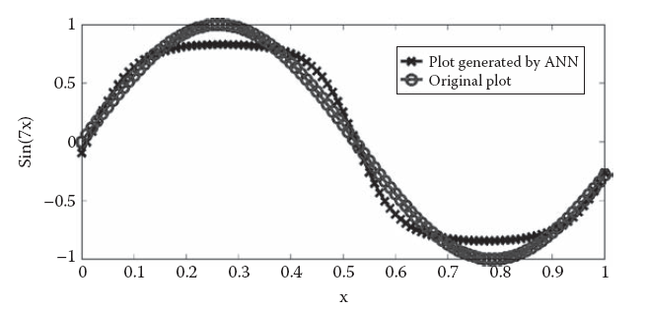
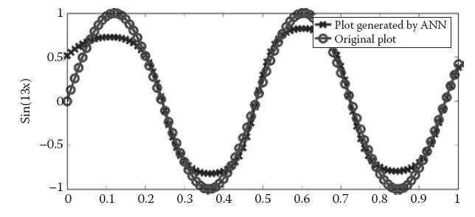
Number of Hidden Layers

Slide 11
Number of Hidden Layers
In order to prove this, we do another experiment. We use the simple sin function that has been scaled in the x axis.
We solve this for three functions that have increasing number of curves.
We see that the number of neurons keeps increasing as we increase the number of turns.
The plots for three versions of the functions along with the imitated functions are given in Figures in the next slide

Slide 12
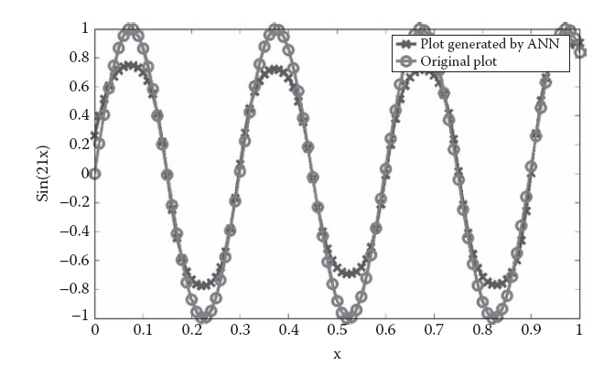
Number of Neurons
FIGURE: Increasing turns need more neurons.

Slide 13
Learning Rate
Learning is another factor that plays a major role in the training of the ANN.
The large learning rate results in the system failing to converge to minima.
The system keeps oscillating between high error values. On the other hand, a very low learning rate results in a very slow movement toward the minima.
Hence the learning rate at one end determines the amplitude of the oscillation of the error values in the error minima valley.
At the other end, it determines the speed at which the system moves towards the minima.

Slide 14
Learning Rate
We try to see the effect produced in the final output if we keep increasing the learning rate.
We saw that when very small number of epochs was allowed (300), very low and very high learning rates gave a very poor performance.
The performance was best for the medium learning rates.
Previous figures show the graphs when the system was trained with learning rates of 0.001, 0.1, and 3 respectively.
Next figures show the corresponding training curves.

Slide 15
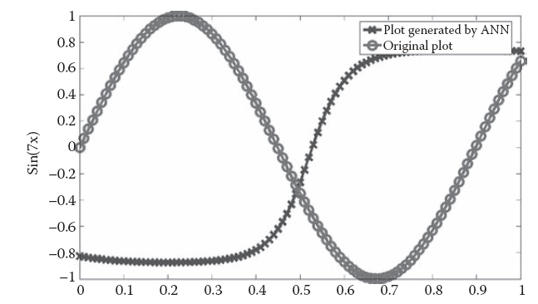
Learning Rate
FIGURE: The effect of learning rate in system performance.

Slide 16
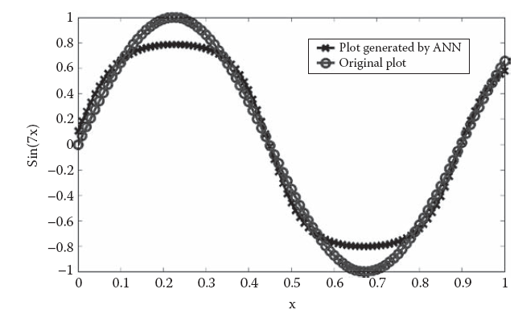
Learning Rate
FIGURE: The effect of learning rate in system performance.

Slide 17
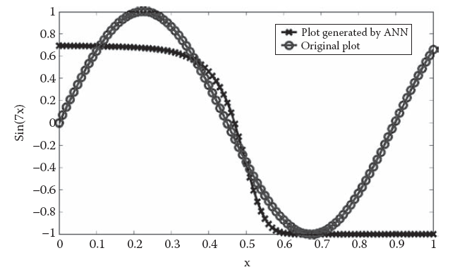
Learning Rate
FIGURE: The effect of learning rate in system performance.

Slide 18
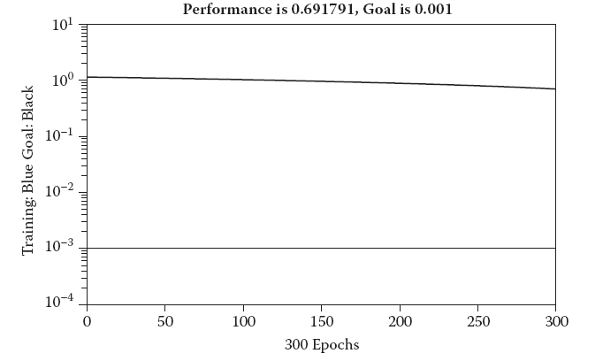
Learning Rate
FIGURE: The effect of learning rate in training curve.

Slide 19
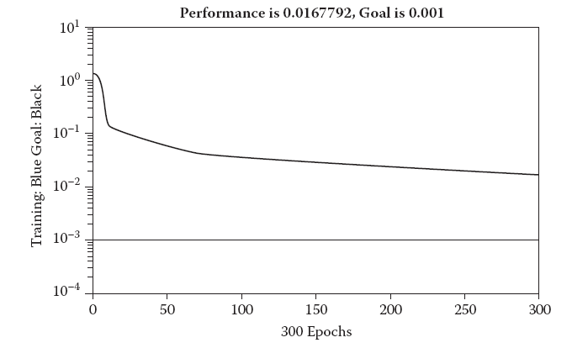
Learning Rate
FIGURE: The effect of learning rate in training curve.

Slide 20
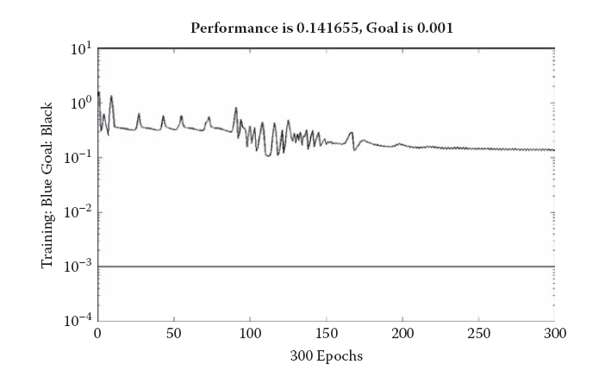
Learning Rate
FIGURE: The effect of learning rate in training curve.

Slide 21
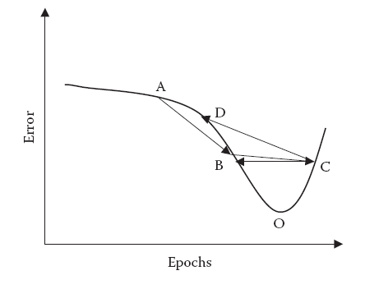
Learning Rate
FIGURE: The effect of learning rate in training curve.

Slide 22
Learning Rate
The errors at points B and C are exactly the same. Therefore the training curve shows no change in error and there is a line parallel to the x axis in the training curve.
After the system reaches point B, it may happen that it lands at point D at the next jump.
Here the error is larger than that of points B and C. Depending
upon the location, the next jump might take the system at some point of higher or lower error.
This would go on and on. Since the error is decreasing and increasing, the change will be visible in the training curve over some region.
This is something that we see as visible oscillations in the training curve.

Slide 23
Variable Learning Rate
The learning rate plays a key role and must be chosen judiciously for better performance of the algorithm.
The algorithmic performance depends upon the learning rate to a very large extent.
Choosing a constant learning rate is disadvantageous, as advantages of the larger and slower learning rates are not regarded.
The faster and slower learning rates, on the other hand, are useful at different amounts of times.

Slide 24
Variable Learning Rate
Initially the system is at a point where the minimum is quite far off. Hence the learning rate must be high in order for the system to approximate the minima as soon as possible.
Hence the learning rate is usually kept high at the start of the training. Now as the system approaches the minima, there are chances of oscillation due to the high learning rate.
Hence at this stage we need to slow down the learning rate. Also the lower learning rates are preferable, since the system is quite close to the minima and hence will be easily able to reach them without much loss of time.
Hence a lower learning rate is desirable. In other words we start with larger learning rates and in the course of time we keep decreasing the rate.

Slide 25
Variable Learning Rate
Ideally the momentum will pull out the system the moment it spends some considerable amount of time there.
This is to save the system from being trapped in local minima. Hence we need to incorporate this in the algorithm as well.
Whenever the momentum pulls out the system out of the local minima, the learning rate should be kept high.
This will enable the ANN to reach the next minima as soon as possible.

Slide 26
Variable Learning Rate
In short with the use of a variable learning rate, the basic strategy is simple.
We see if some movement is resulting in an increase in error or a decrease in error. If the error is decreasing, it means that the ANN is marching toward the minima.
We hence increase the learning rate. This is done with the belief that the ANN will not be in an oscillatory position till the error starts increasing.
If, on the other hand, the error happens to increase, we interpret this as the start of possible oscillations.
We hence decrease the learning rate in such conditions.

Slide 27
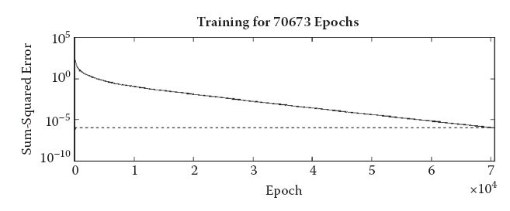
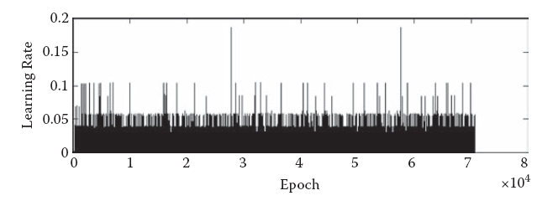
Variable Learning Rate
Here it may be seen that the training error keeps reducing uniformly while the learning rate
Changes a lot. Learning rate may be seen to oscillate between values. This is a combined
result of the momentum and the position w.r.t. the minima.

Slide 28
Momentum
The momentum is a tool to pull out the ANN from local minima.
This ensures that the ANN does not get trapped in any local minima.
This increases the chances of the system to reach the global minima.
People may often try to sub optimize their problem with the hope of getting lower errors in a way that may not be globally best but still within desired limits.
This may make them fix a low value of the momentum.

Slide 29
Momentum
Another set of people may believe in wandering and trying to cover the entire configuration space with the hope of finding the optimal point.
This results in keeping very large values of momentum.
However, this again has limitations. The high momentum will restrict the ANN from going into any level of depth to search for the minima.
Even if a global minimum is in the vicinity, it might actually get missed as a result of the wilderness.

Slide 30
Momentum
We had kept the momentum zero when we studied the learning rate.
This made it possible for us to cleanly study the learning rate without the effect of the momentum.
But unfortunately the converse is not true. We naturally can’t keep the learning rate zero to study the effect of the momentum.

Slide 31
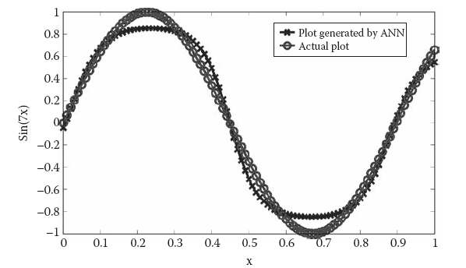
Momentum
FIGURE: Output curve with 0 momentum in global minima.

Slide 32
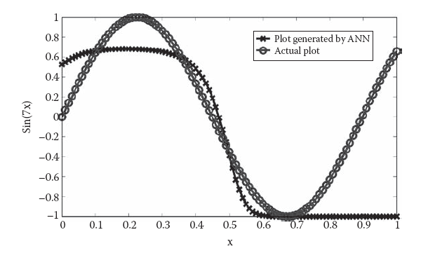
Momentum
FIGURE: Output curve with high momentum in global minima.

Slide 33
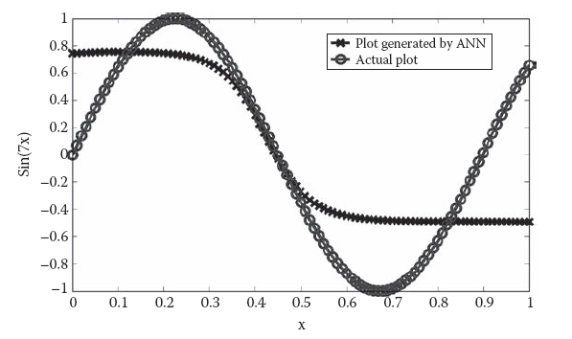
Momentum
FIGURE: Output curve with low momentum in global minima.

Slide 34
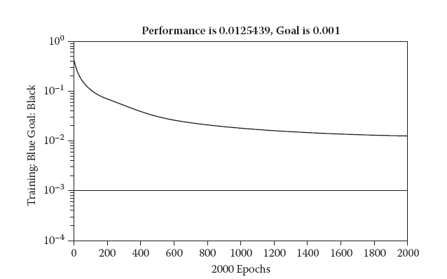
Momentum
FIGURE Training curve with 0 momentum in global minima..

Slide 35
Training Time, Epochs, and Over-Learning
We had kept the momentum zero when we studied the learning rate.
This made it possible for us to cleanly study the learning rate without the effect of the momentum.
But unfortunately the converse is not true. We naturally can’t keep the learning rate zero to study the effect of the momentum.
The ANN curve is many times viewed as the curve where the error keeps reducing with the number of epochs. Even though the change is very small, people like to invest time.

Slide 36
Training Time, Epochs, and Over-Learning
It is natural that misconceptions lead to waste of time. An ANN trains itself to the maximum in the first little iteration.
This is due to the steepest descent approach that is followed by BPA for the training purposes.
Afterward the training makes much less difference.
The ANN needs time to get out of the local minima, get re-trapped in others, and so on till it finds global minima.

Slide 37
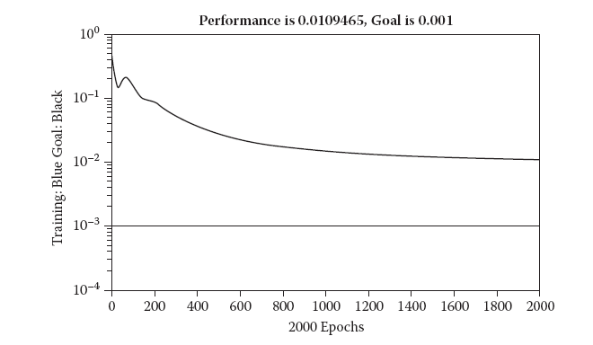
Training Time, Epochs, and Over-Learning
FIGURE: Training curve with high momentum in global minima.

Slide 38
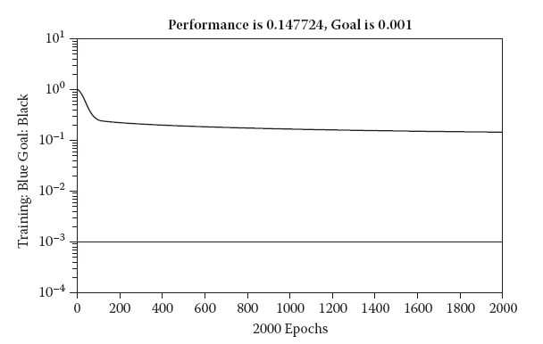
Training Time, Epochs, and Over-Learning
FIGURE: Training curve with low momentum in local minima.

Slide 39
Training Time, Epochs, and Over-Learning
Many times the ANN carries neurons more than usual. This results in the ANN being able to imitate more complex functions than it usually may.
Training for longer times or larger epochs may actually result in the ANN having a very long time to complicate the actual function.
This basically happens as the ANN tries to keep the errors as small as possible and in the process ends up in over fitting the training data points. Hence the training may reduce the system performance if tested on the testing data.
The unnecessary complication of the imitated function by increasing the number of epochs is termed overlearning.

Slide 40
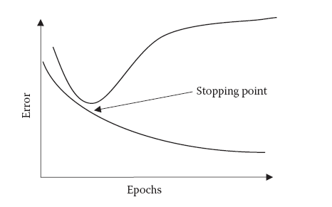
Training Time, Epochs, and Over-Learning
FIGURE: The early stopping.
.

Slide 41
Validation Data and Early Stopping
The ANN must be trained for a limited number of epochs. But the question is how to decide the actual number of epochs.
This may be done by using the concept of validation data. These are special data items that are reserved to carry forward validation.
As we start training the ANN, first the error on both the training and the validation data will decrease.
However as we continue, the error on the training data will decrease and that of the validation data will increase.
This is the region when the ANN is complicating itself more than required degree.

Slide 42
Goal
The goal plays a role only as a member of the stopping criteria of the algorithm.
The training stops immediately when the goal is met. The actual goal is set based on these observations.
It may be noticed that the goal may scale the error function such that many times the same training curve may be interpreted differently for different goals.
We may look at a training curve and say that the training did not reduce the errors. But this might not be true.
The illusion of low training might be because the goal might be too low

Slide 43
Goal
People suppose that an ANN with its goal not met is worthless.
Even if the ANN almost reached the goal, they will not test the system.
Rather they work with the goal or other parameters in order to make the goal meet. This, however, is not a valid approach.
At every stage of an ANN, the system is ready for testing with the general performance and the error level prevalent in that part of the training curve.

Slide 44
Input Distribution
The inputs must be normally distributed in this range, covering as many areas of the input space as possible.
Another major feature is that noise must be as low as possible. The testing data best performs if it has enough training data available, preferably in the vicinity.
For almost all real-life problems, patterns exist in the training data that the ANN tries to exploit.
For classificatory problems, the interclass distance must be as large as possible and the intra class distance must be as small as possible for the best results.

Slide 45
Randomness
This is a very common experience and may happen to many people: that the same code gives a very bad result which was earlier giving good results.
This is that the ANN may be using random weights and biases as the initial parameters
The ANN even before a single epoch assumes random values for all of these.
This may be visualized as the ANN randomly places the system at some point in this highly dimensional configuration space.
Then starts the journey aimed at lowering the error.

Slide 46
Randomness
Now if the random placement of the ANN places it at a location that is somewhere in a valley comprising the global minima,
the system will readily converge to attain the global minima.
If, on the other hand, the ANN is initially placed in a local minimum surrounded by lots of local minima,
it will get trapped again and again at the minima. The performance will naturally be very poor no matter how long you train.

Slide 47
Generalization
Generalization is the property of the ANN that helps it to give correct results to the unknown inputs.
We have discussed various issues and factors affecting generalization.
These are the training parameters, input characteristics, and function and problem characteristics.
To add to all this, we present another point of view of generalization in this section: the globalized learning strategy of the ANN.
Here we discuss the role of ANNs as functional regressors where they fit any curve over the training points by varying their weights.

Slide 48
Generalization
The ANN with BPA always tries to find global patterns, global rules, and global characteristics from the data presented. It tries to find a function (whose complexity is decided by the number of neurons and layers) that best fits the training data points.
Each and every neuron has a contribution to make here. The change in weight of every neuron affects the output of all the training data items.
The whole function may change as a result of the change of one particular weight.
This is the globalized nature of the use of ANN with BPA, where all the training data set items are seen as a global function that the system is asked to imitate.

Slide 49
Generalization
We may do something so that the output of only this particular input gets improved without disturbing the rest of the system.
Here each input is evaluated against the global trends, and the modifications carried out in the weights are dependent on the contribution of this input in the total set of inputs given to the ANN as the training data set.
Hence the ANN may completely reject some input or class of inputs and disregard them, as they might fail to fit in what the global understanding of the ANN reveals.
It is also possible that some set of inputs affect the ANN to the extent that the trends present exclusively in this part of the input are generalized as global trends and the system implements them at the globalized level.

Slide 50
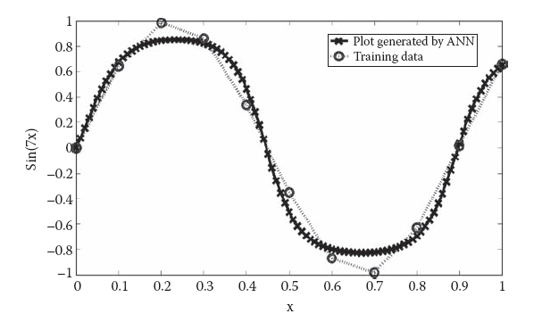
Generalization
FIGURE: The artificial neural networks as regressor.

Slide 51
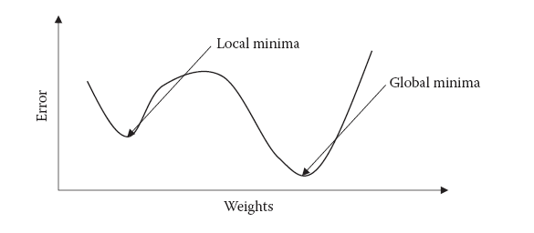
Global and Local Optima
Whenever you are at a minimum, how to decide whether it is a local minimum or a global minimum?
Try to find out all the valleys and their minima. At the end, the one with the lowest value is regarded as the global minima and the rest as local minima.

Slide 52
Noise
Whenever you are at a minimum, how to decide whether it is a local minimum or a global minimum?
Try to find out all the valleys and their minima. At the end, the one with the lowest value is regarded as the global minima and the rest as local minima.
The ANNs try to make patterns or rules that give the least errors or fit in the outputs to the greatest extent possible.
It may be seen that however generalized or globalized the system is, the effect of noise will be reduced.
This is because the output is not disturbed much by the temporal noise in the vicinity of the inputs. This is the case with most localized networks where the output largely depends upon the surrounding outputs.

Slide 53
Noise
Whenever you are at a minimum, how to decide whether it is a local minimum or a global minimum?
Try to find out all the valleys and their minima. At the end, the one with the lowest value is regarded as the global minima and the rest as local minima.
The ANNs try to make patterns or rules that give the least errors or fit in the outputs to the greatest extent possible.
It may be seen that however generalized or globalized the system is, the effect of noise will be reduced.
This is because the output is not disturbed much by the temporal noise in the vicinity of the inputs. This is the case with most localized networks where the output largely depends upon the surrounding outputs.

Slide 54
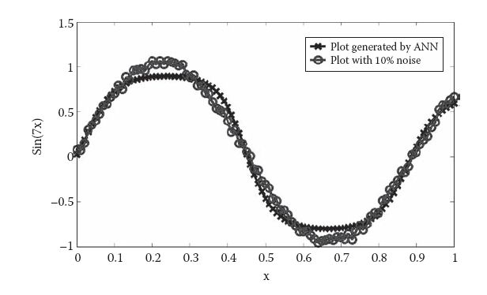
Classificatory Inputs
FIGURE: Plot with 10 percent noise.

Slide 55
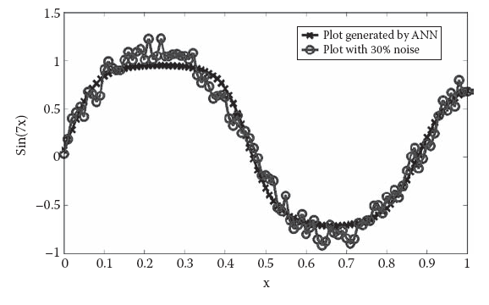
Global and Local Optima
FIGURE: Plot with 30 percent noise.

Slide 56
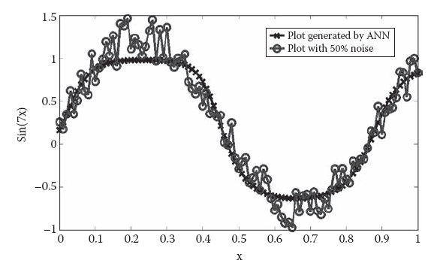
Classificatory Inputs
FIGURE: Plot with 50 percent noise..

Slide 57
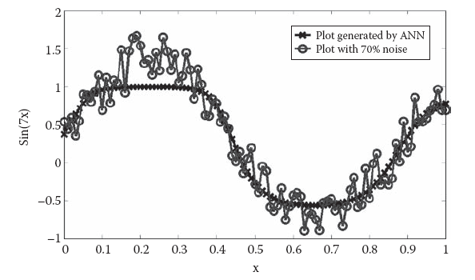
Classificatory Inputs
FIGURE: Plot with 70 percent noise.

Slide 58
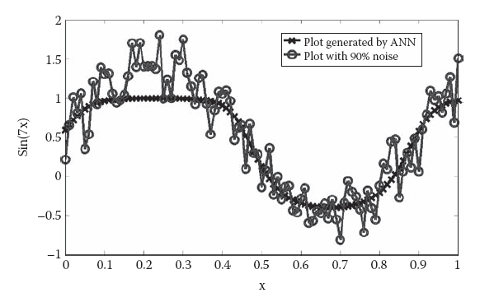
Classificatory Inputs
FIGURE: Plot with 90 percent noise.

Slide 59
Global and Local Optima
The effect of the classificatory inputs is more profound when the percentage of classificatory inputs is rather high as compared to the other inputs in the system.
Also it depends upon the number of classes in the system (n). The system has bad performance if the number of classes is
high.
Classificatory data is a natural problem. It may be seen that this type of input in common understanding exists at either of the two extremes of the axis.
This if seen with regard to the non classificatory inputs is a very bad thing, where we keep talking about a small change in input corresponding to a small change in output.

Slide 60
Global Not All ANNs Get Trained and Local Optima
The BPA can only make an attempt to train the ANN.
It does not have any guarantee that the ANN will get trained with good performance in the training as well as the testing data sets.
However much you wish, you cannot force the ANN to train itself.
It may happen that some very important attributes are missing in the system, and that is causing problems in the training.
The ANN can withstand noise to a large degree, but this always has disadvantages.
The extra noise will reduce system performance by a very large degree, and the system might ultimately fail to train itself.

Slide 61
ANN with BPA as Classifier
The ANN we discuss here is based upon the classificatory model. Here there are as many outputs as there are classes.
Each output here denotes a class.
The output numerically stands for the probability or chance for the given input to belong to the class being considered.
Suppose that the system has a record of n different users. Here there will be n different outputs for every input I of the form <o1, o2, o3…, on>, where any general output oi denotes the probability that the input I belongs to the class i.

Slide 62
ANN with BPA as Classifier
The probability can be a maximum of 1 and a minimum of –1.
A probability of 1 denotes that the input for sure belongs to the same class and a probability of –1 means that the input for sure does not belong to the same class.
Hence whenever we apply any input, the system gives us n number of outputs.
We now select the maximum of the outputs, and the class corresponding to it is returned as the answer.
Ideally one on the n outputs must be 1 and the rest must be –1. But in reality this will not be possible for obvious reasons.

Slide 63
ANN with BPA as Classifier
These ANNs use BPA as the training algorithm, which attempts to set the values of the unknown parameters in such a way that the total error for the training data set is reduced.
The BPA fixes the values of the parameters of the system or the weights in the same respect.
It tries to keep the boundary separating the class regions and the non class regions as optimal as possible. If any data set belongs to the class, it tries to modify the parameters such that this training data set lies in the class region as comfortably as possible. This means that the surrounding areas are also likely to lie in.
The converse is true if the data set does not belong to the class. Here the BPA tries to completely remove the data set from the region accommodated by the class.

Slide 64
ANN with BPA as Classifier
This will result in the parameters being adjusted in a manner that this point is nowhere near the region accommodated
by the class.
As we increase the number of neurons in the hidden layer, the number of parameters in the system keeps increasing. This makes the system even more flexible.
If the number of neurons is far too many, the ANN will be very sensitive.
This will enable it to make very rapid or sharp transitions in very little space.

Slide 65
NN with BPA as Functional Predictor
This will result in the parameters being adjusted in a manner that this point is nowhere near the region accommodated
by the class.
As we increase the number of neurons in the hidden layer, the number of parameters in the system keeps increasing. This makes the system even more flexible.
If the number of neurons is far too many, the ANN will be very sensitive.
This will enable it to make very rapid or sharp transitions in very little space.

Slide 66
Radial Basis Function Networks
The radial basis function network (RBFN) is the other ANN model that we discussed. We first discuss their roles in classificatory problems and then in functional prediction problems.
The RBFNs select some training data sets that act as the data centers or guides for the rest of the training and testing data.
Each guide has an effect on the entire input space. The effect decreases as we move further from the guide.
Here the result is more dominated by the guides that were very close to the unknown inputs and very much less or negligibly by the ones that were far apart.

Slide 67
RBFNs as Classifiers
Dealing with localized networks, we expect better performance, as the classification problems are known to be highly localized in nature.
The localized nature of RBFNs works very well in the case of classificatory problems where every neuron covers a fixed set of regions that may even include the entire class.
It must be noted that even the ANN with BPA actually is unable to imitate the binary function due to its characteristic nature where the outputs may not change at all over any change in inputs but then suddenly change.
In short, the RBFN works in a localized manner to predict a function that correctly classifies inputs into outputs according to the threshold values. The localized approach results in faster training.

Slide 68
RBFNs as Functional Predictors
For functional prediction problems, more or less the same concepts hold and work to make these great functional predictors as well.
Functional prediction problems usually involve smoothly changing functions as we move across the input space.
This is what happens when the distant guides make their contribution. They induce the effect of the global trends over these networks, and this makes them behave as per the demands as well as the requirements of the global map as well.
Hence we are able to further predict the system output on the unknown inputs by all these kinds of inputs.
They ensure that the continuity of the input surface is maintained and that the surface behaves as well as possible considering the nature of the real-life application.

Slide 69
Role of Radius of RBFNs in Generalization
These ANNs have a very important parameter that needs a special mention because of its functional characteristics and its effect on the resulting RBFN.
This parameter in the RBFN should be as large as possible, as it corresponds to the maximum degree of generalization.
The spread looks after the level of influence that each of the data centers or guides may have over the other regions.
We studied how the localized systems take the outputs in the close vicinity and on this basis decide the final system output.
This would be more or less a weighted mean of a couple of values that becomes the final output of the system. The global trends would all be absent.

Slide 70
Self-Organizing Maps
Self-organizing maps (SOMs) constitute another implementation of the ANN.
These employ an unsupervised training algorithm where the patterns are found in the inputs, which are also used to map the outputs to these inputs.
Given this characteristic, it is clear that SOM does not use global rules for calculating the outputs as is the case with ANN with BPA.
Such an approach serves as a very big boon for the classificatory problem where the output consist of classes that ideally have very small intraclass and very high interclass distances.
The results obtained by SOMs are usually better than those from many other approaches when applied to the classificatory problems.

Slide 71
Self-Organizing Maps
Another characteristic of the SOM is its clustering nature. We saw how this clustering nature results in better performance in classificatory problems, but this is not the end.
This forms a very fast technique of good clustering which leads to effective distribution of data among the modules of the MNN.
This is again attributed to the training algorithm of the algorithm, where the negative effects of noisy data get canceled by the rest of the data.
This is because the nearby inputs are consulted to calculate the final output of the system. In case the noise can damage one such input that is consulted by the system for the calculation of output to any system, the system may not give the correct results.

Slide 72
Learning Vector Quantization
The LVQs also represent a localized approach to problem solving by the use of ANNs. LVQs may be considered even more localized models as compared to the RBFNs due to their working.
In these networks also a single neuron may itself be able to predict a large number of training data sets by actually enclosing a large region in the input space.
For all these ANNs, we comment in general that they will be able to learn almost any training input data if we keep increasing the number of neurons.
In ANN with BPA, the function that the ANN tries to predict keeps getting sensitive to inputs and changes rapidly on increasing the number of neurons.

Slide 73
FUZZY INFERENCE SYSTEMS
Fuzzy inference systems (FIS) were another very active tool that we used for problem solving in this text.
Both ANN and FIS are intelligent systems. They are used to give correct outputs for the inputs presented.
ANN training usually happens with a great ease when the rules that map the inputs to the outputs are simple enough.
The same is true for the FIS as well. If an FIS does not perform well, we may make necessary modifications.
Hence it may be seen that the neurons and connections in ANN are largely similar to MFs and rules in a FIS. The FIS, however, needs a fair idea of the initial rule and an understanding of the system.

Slide 74
Number of Rules
In the preceding section, we studied the fact that the number of rules was analogous to the number of neurons in the ANN.
This means that if a rule is being added for some membership function (MF) of the system, then it is likely that equivalent rules are added for all the MFs of the concerned input.
The second important point here is that the rules may usually be added in the system when the designer realizes and confirms through testing that the system is not performing as per the requirements in certain conditions.
It may be seen that the system should perform well for this situation now. If it doesn’t perform, then the designer will naturally be capable enough to modify the rule set to make it perform.

Slide 75
Number of Membership Functions
The number of MFs in FIS plays more or less the same role as the number of layers in the ANNs. We definitely do not mean the same in the absolute sense.
The MFs are usually added in case the system is unable to perform with a lower number of MFs.
The addition of MFs gives a greater flexibility to the designer to map the inputs to the outputs.
These rules go a long way in fixing the system, especially as per the known cases. But the addition of MFs has the same ill effects that we discussed for the number of rules earlier.
Then only if very necessary increase the number of MFs for any input or output. One must be aware of the cost of adding the MF.

Slide 76
Weights of Rules
The FIS gives an additional feature, that of weighing of rules. This is not necessarily the same as the role of weights in the ANN.
Still, weights happen to be very strong agents to adjust the system as per requirements. The use of weights is even more important at design time when the initial rules are framed.
Looking at all these situations, it is clear that rules may be used to improve the system in terms of design, logical understanding, or practical performance.
One must avoid such things unless it is possible to appreciably test all the possible input types.
Modification of weights is best if it I supported by a common sense understanding or an understanding of the linguistic representation of the system.

Slide 77
Input/Output Distribution Between MFs
The distribution of input and output ranges among the MFs is one of the most interesting things to observe in the FIS.
It may be noted here that there is no clean distribution of the ranges among the MFs.
Rather the distribution is fuzzy, starting from a membership value of 0, attaining its peak at a membership value of 1, and then again dissolving to a membership value of 0.
It may again be recalled that we advocated modeling the problem in ANNs such that the inputs are equally distributed in the ANN.
The preceding discussion speaks of the same issues where we adjust the parameters in place of adjusting the system inputs.

Slide 78
Shape of the MFs
Various functions are used in the design of MFs in FIS. All these model the MF in their own manner and denote the way in which the membership of the input or the output changes from a membership value of 1 to a membership value of 0.
In order to decide the shape of the MF, we need to know how the applicability of some rules may change with respect to the change in the inputs and outputs.
Based on these discussions, let us analyze the MFs given in Figures 19.14a through 19.14d. These correspond to triangular, Gaussian, sigmoidal, and Z-shaped MFs.

Slide 79
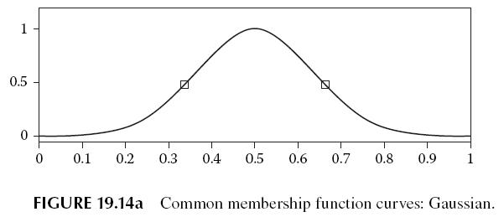
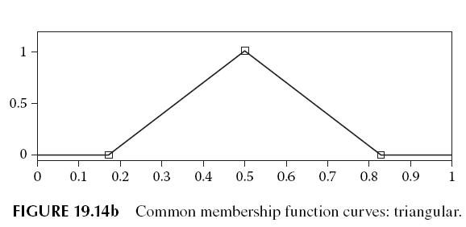
Shape of the MFs

Slide 80
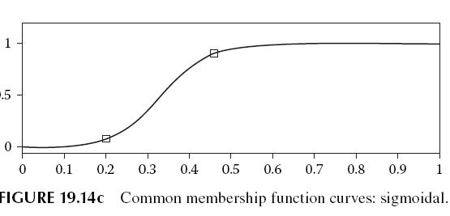
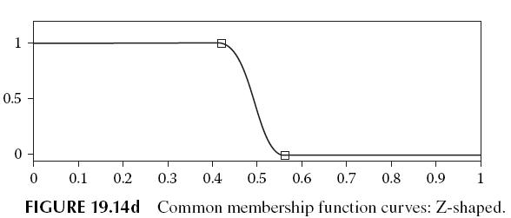
Shape of the MFs

Slide 81
Shape of the MFs
The Gaussian MF is used in situations that mark a rise in membership value to a maximum and then a drop again to a minimum.
The triangular MF, on the other hand, represents a gradual increase and decrease in the membership value.
This MF forms the basis of design in many simple applications and functions mostly depicting a linear change of outputs with inputs.
This rate is important to be studied for any MF with respect to the problem demands discussed earlier. A similar MF is the Z-shaped function.
Here there is a sharp region where the change from maxima to minima occurs. This region may be controlled by parameters.

Slide 82
Manual Modify and Test
Naturally we did not apply this much over the real-life problems apart from some control applications.
The problem solving in FIS is an iterative process where we make a model and keep modifying the model until satisfactory results are achieved.
Next the rules are framed using common sense. Once this model is ready, it is tested by the simulation engine or known inputs or common sense.
The modified FIS is again tested in a similar manner, and this process continues until we get the desired output for all inputs.

Slide 83
Generalization
We talked about generalization in all respects when we discussed the various models of ANN. We even discussed generalization under various heads of FIS.
The basis of FIS is not that of a localized system. Here the rules are meant to depict the system in linguistic terms.
These rules are the result of the neighboring inputs and outputs that were known to the designer.
The level of generalization largely depends upon the number of rules and MFs per input and output.
This may again be attributed to the range of inputs covered in case we increase the number of rules or MFs.

Slide 84
Can FIS Solve Every Problem?
We studied earlier that ANNs cannot solve all kinds of problems. The FIS forms a different type of solution, one that is driven by rules.
The only way to solve the problem if exceptions occur is to apply fixes in the form of MFs, and the rules that we saw were not good techniques for problem solving.
The resulting solution would be much localized and naturally unlikely to be called an effective real-life solution.
Our discussion of FIS in this section was restricted in many ways to the general manner of problem solving in FIS.
Here the whole orientation will be toward the manner in which the ANFIS depicts and solves the problem.

Slide 85
EVOLUTIONARY ALGORITHMS
The evolutionary algorithms (EAs) or in particular the genetic algorithms (GAs) were another widely used technique for solving real-life problems in this text.
Here we mainly used these algorithms for the purpose of optimization.
This enabled the effective use of the GA in real-life applications. The GA as well must be used with care.
The GA involves numerous parameters, tips, and techniques that many times people may get wrong, and the resulting solution may be suboptimal in nature.
Sometimes the solution may not be good at all. Here we discuss the major issues around the use of the GA.

Slide 86
Crossover Rate
The crossover is the operation where we try to mix two individuals in order to generate a new individual in the next population.
A very high crossover rate results in very fast convergence of the various solutions to a point.This can be verified by the general working of the algorithm.
On the other hand, a very low crossover may lead to the algorithm behaving very randomly. The GA is used to enable generation of the best results in the finite period of time.
In general a crossover rate of about 0.7 is justifiable. This may be increased or decreased, considering the convergence of the system as well as the total time taken for the convergence.
Also as we lower the crossover, the mutation becomes effective and the randomness increases.

Slide 87
Mutation Rate
Mutation is the exact opposite of crossover.
Crossover leads to the convergence of the various individuals, which ultimately results in the contraction of the search space.
Mutation, on the other hand, tries to throw the individuals far apart and results in the expansion of the search space.
The mutation rate covers the percentage by which the individual may be thrown or displaced in the search space.

Slide 88
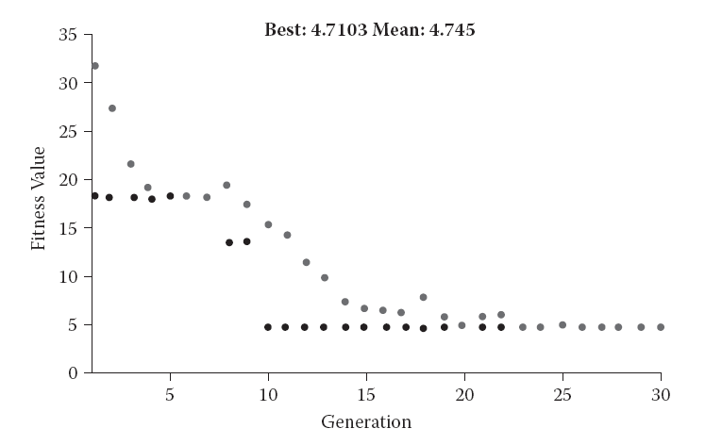
Mutation Rate
The convergence of the genetic algorithm for crossover of 0.

Slide 89
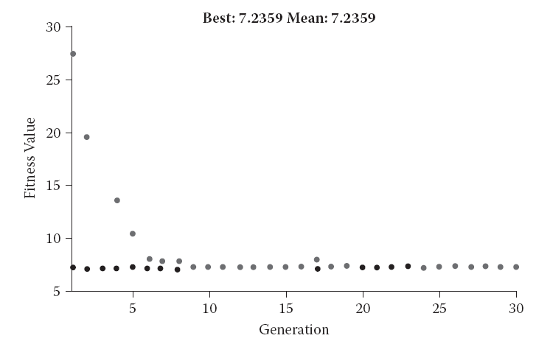
If the mutation rate is low, that means the newer individuals would be in almost the same positionwith almost the same fitness as the parent. This means that the mutation did not affect the system much and the system will continue to converge early as per the crossover operation.
This is undesirable for the system for the same reasons that we presented in the case of early convergence with large crossover rates.
The convergence of the genetic algorithm for crossover of 0.7.

Slide 90
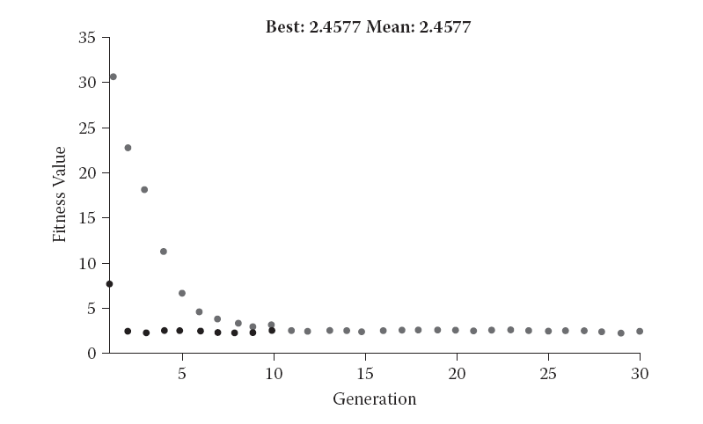
If the mutation operator is very large, the new individual lands at some unknown place in the search space. This means that the new individual will have any random fitness, depending upon its location. We may not be able to predict the fitness value at all.
By contrast with the case of crossover, the mutation must be kept reasonably low to allow the system to converge. The mutation may be increased in case the system shows signs of fast convergence.
The convergence of the genetic algorithm for crossover of 1.

Slide 91
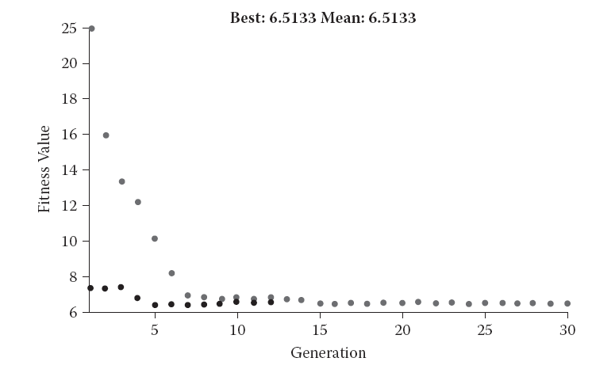
We again use Rastringen’s function to study the effects of mutation. Figures below show the system convergence when the mutation was fixed to values of 0, 0.1, and 1 respectively.
The effect of the randomness may be easily observed by looking at the graphs. As we increase the mutation, the randomness increases and the convergence decreases.
Randomness and convergence in the case of a mutation of 0.

Slide 92
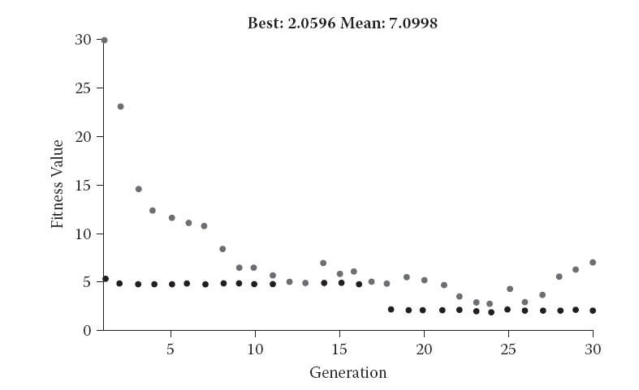
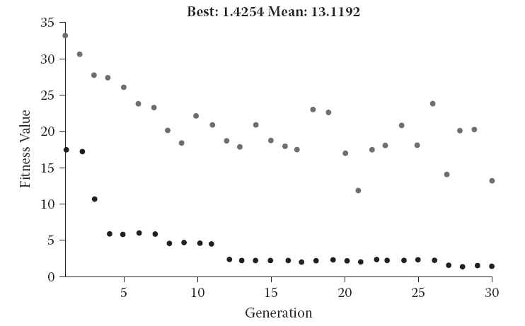
Randomness and convergence in the case of a mutation of 0.1.
Randomness and convergence in the case of a mutation of 1.

Slide 93
Individual Representation
This is one of the most artistic tasks of the GA. The whole working and performance of the GA depends upon the manner by which its individual has been represented.
The individual representation is not a parameter that may be varied to control the system performance.
This leads many people to the overlook the mechanism of individual representation, which badly affects system performance.
There are numerous issues that must be studied for the design of a good individual representation.

Slide 94
One of the major issues associated with the individual representation is that of feasibility. It must be ensured that the solution is feasible even if generated randomly.
This adds a lot to the algorithmic performance, as infeasible solutions have a very bad impact on the performance of the system.
The same thing holds true for the generic operators as well. All the genetic operators, especially the mutation and crossover, must ensure that they result in feasible solutions.
The individual representation must be such that it caters to the generation of feasible solutions to the largest extent. Also the crossover of two good solutions must usually mean a good solution.

Slide 95
Infeasible Solutions
The aim of the GA is to minimize the number of infeasible solutions at every step.
The infeasible solutions restrict the performance of the optimization by wasting individuals that happen to lie in the infeasible areas.
One will have lesser dimensionality, and the other will have a high dimensionality.
There are two major ways of handling infeasible solutions. The first way is to assign the infeasible solutions a very high fitness value.
The second way is that we employ a repair operation in GA. The repair would result in correcting the inappropriate values and assigning feasible values as per the logic.

Slide 96
Infeasible Solutions
The choice of method between the two is largely dependent on the problem. If the problem has a very high occurrence of infeasible solutions, the repair operation may be preferred.
Also if the crossover of good, feasible solutions can give an infeasible solution, the repair method may be better. This is because we cannot expect a very large number of solutions to be deleted, as is the case with fitness method.
Also if again and again infeasible solutions keep creeping up in large numbers, they will affect the total populations and hence cannot be entertained.
If, however, infeasible solutions are few in number and have a limited occurrence, the fitness function may be used. This method will result in deletion of the infeasible solutions as the generations increase.

Slide 97
Local and Global Minima
The local and global minima are always a point of concern in the design of any system.
The GA is better when it comes to escaping from the local minima and trying to find the global minima in the entire search space.
The various individuals of the GA may be regarded as the agents that try pick up a location and search for the possibility of global minima there.
The agent that has the highest fitness value is likely to be near global minima and hence attracts other agents.
The diversity preservation technique facilitates the saving of features that further help in the search for global minima.

Slide 98
Local and Global Minima
The convergence in this sense is when the system tries to give up further exploration and tries to concentrate more upon the searched areas.
It may be viewed as a phenomenon where the system gives up its search for the global minima and decides to find the global minima in areas where so far the least fitness value is found.
Mutation or the application of randomness, on the other hand, encourages the system to find the global minima and treats all the present minima as local minima.
The use of correct crossover and mutation rates may hence be appreciated in lieu of global and local minima as well. There is no doubt that these rates decide the convergence to local or global minima.

Slide 99
Optimization Time
Shortage of time was the basic reason for the use of GA here of BPA in the case of ANN
The beauty of the GA or BPA is that they convert the infinite possibilities to a framework that uses an iterative approach to finally come to an answer that maximizes the optimization with respect to time.
Unlike the ANN, the GA has no ill effects of long optimization time except that the optimization time may not result in improved performance, resulting in wastage of time.
The hope or the probability of generating a more optimal solution is very much reduced after the system has converged.

Slide 100
Optimization Time
It may not be profitable to keep the system running long after convergence.
This was what we concluded in the case of ANNs as well. It may still be profitable if the entire population pool is spread far apart and the search goes on.
This, however, is seldom carried out; as it is believed that the GA must have searched for most of the interesting areas and must have tried to converge if there was a possibility of global minima.
The ANN counterpart of this would be to train the system again, but this is not usually carried out in training by BPA.

Slide 101
HYBRID ALGORITHMS
The hybrid algorithms are a mixture of the simple algorithms and make use of these algorithms in characteristic architectures to solve the problem given.
These algorithms obey the laws of the constituent algorithms to a very large extent.
Hence we may generalize the guidelines of the constituent systems to these systems as well.
This means that if the ANFIS is being used, it will follow the rules and guidelines of both the ANNs and the FIS.
We need to take care of the points presented in both these systems in the use of ANFIS.

Slide 102
ANFIS
ANFIS is a hybrid system where a fuzzy model is trained by use of ANN training.
If we overlook the ANN that is used for the training purposes, the ANFIS happens to be a FIS.
The FIS has a great capability to map inputs to outputs according to a set of rules that are cautiously framed considering the system behavior.
These systems denote the natural way in which things work out.
Here the output at any point depends upon the rules that drive the system and are made up from study of the system.

Slide 103
ANFIS
Now we discuss the working of the fuzzy systems with relevance to the classificatory problems.
We consider the problem of finding out the presence of disease, where the task is to classify the input in one of the two classes, depending on whether disease exists or not.
Other types of classificatory problems may be broken down to this type by considering each output as to whether this class is found or not.
This is the same modeling of the output that we considered in case of the ANNs for the classificatory problems.

Slide 104
ANFIS
In case of the classificatory or the binary classificatory problem, the FIS must be able to imitate the binary function that gives maxima at regions where the class is found and minima at the regions where the class is absent.
Here we mainly study the rules, as they are the ones that drive the system outputs.
The rules consist of the antecedents and consequents.
The antecedents contain all combinations of the various MFs of the various inputs. Imagine only the antecedents in the input space.
These cover the entire input space, with the membership degree varying at different parts of the input space.

Slide 105
ANFIS
At regions where there is some combination of points where each input has some MF of degree 1, the membership value happens to be 1.
As we move away from this point on any of the input axes, the MF value keeps dropping. It may be noted that we assume the AND operator is used to join the conditions.
Now first we make a big assumption here that may not always be true.
This is that the outputs at these points with membership degrees are well known.
This means that here the output will be minimal or maximal, depending upon the presence or absence of a class.

Slide 106
ANFIS
This also means that the whole input space has fairly separated regions with known or assured outputs.
It may easily be seen that now the MFs may be easily adjusted to accommodate or not to accommodate the known outputs.
The training algorithm so adjusts the graph of the concerned MF to easily accommodate the known input or to completely reject it.
However for the evaluation purposes, a value above a threshold is considered to belong to a class and vice versa.
The FIS is trained by use of ANNs

Slide 107
Ensemble
The ensemble is a modular neural network (MNN) that forms a very promising solution to most of the problems presented. Here we divide the whole problem into modules.
Each module represents an ANN that is trained using its own means independent of all other ANNs or modules.
An integrator collects the results per ANN and uses them to calculate the final system output.
Each time an input is given to the system, it is distributed among all modules or ANNs.
Each decides its own output.

Slide 108
Ensemble
Then polling is done between ANNs by the integrator. The class that gets the maximum votes is declared the winner.
The ANNs are always likely to be stuck at some local minima.
The reason behind this may be the nature of the BPA that tries to calculate the minima from the present location of the network.
The characteristic of the local minima, especially in the case of classificatory problems, is that even though they give correct output for most problems, yet there may be some inputs where they fail to give correct outputs.
Since the total error is appreciably less, it may be assumed that the answer is correct for most problems.

Slide 109
Ensemble
Now if we train an ANN numerous numbers of times, it may again and again get trapped at different minima.
Each minimum will give the correct results to most of the inputs in the input space and wrong answers to some of them.
In other words this ANN can see a large part of the complete picture clearly, but another part is incorrectly visible to it.
At the same time if it were at some different minima, another part would have been clearly visible to it with some other part unclear.
This forms the basis of the ensemble.

Slide 110
Ensemble
Now it may sometimes be argued, why don’t these ANNs return a 100 percent correct output?
The reason is that many times the training data have noise due to which the inputs are present at the wrong locations.
This makes the systems impossible to train unless they are localized to a very small level.
Also many times the outputs have characteristic changes such that it is very difficult to make out the class to which they may belong.
This happens due to the small interclass separations for some inputs that makes these systems very difficult to realize.

Slide 111
Evolutionary ANN
These ANNs evolve with the help of evolutionary algorithms (EAs) or genetic algorithms (GAs).
Here we can keep the entire architecture variable.
Also these methods solve many problems that we face in the training of the ANNs where they get trapped in local minima.
The GA not only decides the correct values of the weights and the biases, but so does the entire ANN architecture.
The evolutionary ANNs are primarily ANNs that are formed and trained using the GA.

Slide 112
Evolutionary ANN
The input space is a high-dimensional space with each axis representing an input.
The output is usually visualized as the vertically top axis. The configuration space is the space where each axis denotes some weight or bias that is used in the ANN.
This is highly dimensional in nature and multiplies its dimensionality on the addition of every neuron to the system.
The error (or negative performance) of the system for the training or the validation data set is usually marked as the vertical axis and plays the same role in our discussions as the output in the input space.
In fixed architecture–type systems, this space is constant. On the other hand, when the architecture of the ANN changes, this space also changes.

Slide 113
Evolutionary ANN
Now let us see what happens at the time of training of the ANN. Here there is a transformation of the status or the position of the system in the configuration space.
In any training algorithm, the intention is to reach a region in this configuration space that gives us the least error or the lowermost point in the output axis.
Now let us move from the configuration space to the input space. Here a position in the configuration space corresponds to an entire function being imitated in the input space.
The point corresponding to the least error in the configuration space means the most ideal imitation of the function serving as a solution to the problem in the input space.

Slide 114
Evolutionary ANN
The change in the architecture is a complexity or the sensitivity control of the ANN.
Architectures with limited connectivity and a limited number of weights prohibit the ANN from imitating complex functions that are prone to too many changes and sudden changes.
The configuration space changes completely if we change the ANN architecture.
A simpler structure due to limited dimensionality of configuration space is much easier to train and find the optimal solution, if the optimal error is up to toleration limits.

Slide 115
Evolutionary ANN
Now let us combine the two and see the working of the GA.
As the configuration space is changing, the discussion requires a much broader insight into the functioning of the ANNs.
Of course, the actual space that incorporates the GA encoding of the chromosome is much easier to discuss, as it obeys all laws of GA and is equally difficult to visualize and comprehend, especially with respect to the ultimate ANN and its performance.
The GA at any time consists of numerous individuals placed at multiple configuration spaces and multiple points at each configuration space.

